Slide 1
Computing top-k Closeness Centrality Faster in Unweighted Graphs
Presentation: Antonis Mouratis,

Slide 2
Motivation
Centrality shows us how important a node is
Closeness centrality informs us how fast the information flows within the network
The aim is to find possible improvements to the algorithms

Slide 3
Aim of the paper
Present two different methods and compare them on various datasets.
Experiment with different values of k.
Validate the intuition that nodes with high degree have lower farness.
Relation between closeness centrality with betweenness and degree centrality.

Slide 4
Related work
Many algorithms on the problem of k-closeness
All based on the APSP
Most implement the BFS method (complexity O(nm))
Need for faster algorithm
Approximation approach

Slide 5
Two ways of computing closeness centrality
APSP
BFS
Matrix multiplication
Both time-consuming
Need for new way of doing it
Use BFS and combine it with pruning

Slide 6
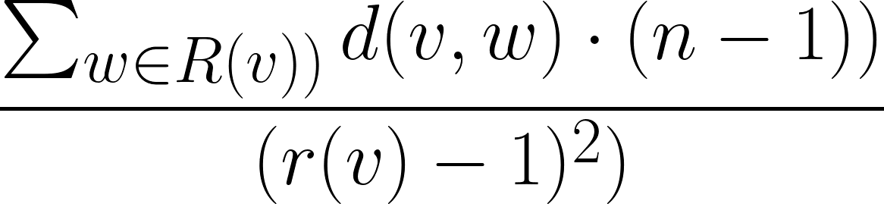



Notations
Given a graph G=(V, E), we define farness f(v) and closeness c(v) as such:
where , R(v) being the set of nodes reachable from v

Slide 7
Overview of the algorithm
The basic idea is:
Create a list Top and a queue Q
The list Top contains the farness value of the top-k nodes
The queue Q contains the lower bound of farness of nodes not yet examined
Both in increasing order
Each time comparing the lower bound to the farness values of the list Top
End when lower bound of w in Q is bigger than the k-th farness value (why?)

Slide 8
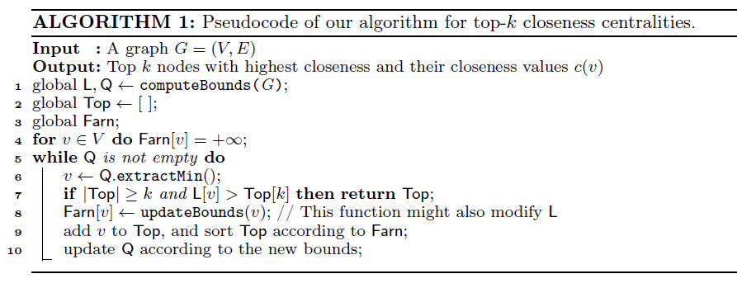

Slide 9
Compute bounds function
Conservative strategy
Intuition: nodes with higher degree have lower farness (examine first)
Aggressive strategy
Neighborhood-based bound computation

Slide 10
Update bound function
Apply BFS on every vertex v to compute f(v)
Stop when it is guaranteed that f(x)>x, where x is the lower bound

Slide 11
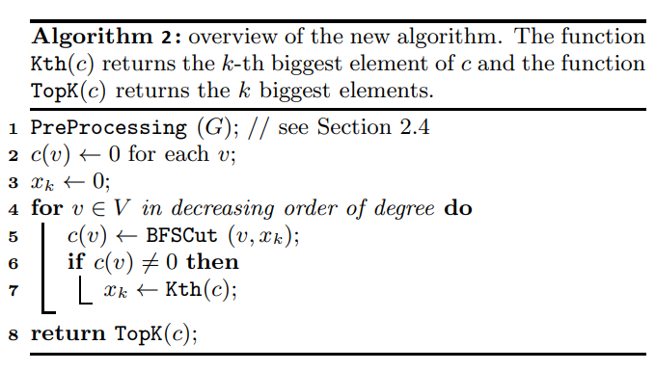

Slide 12
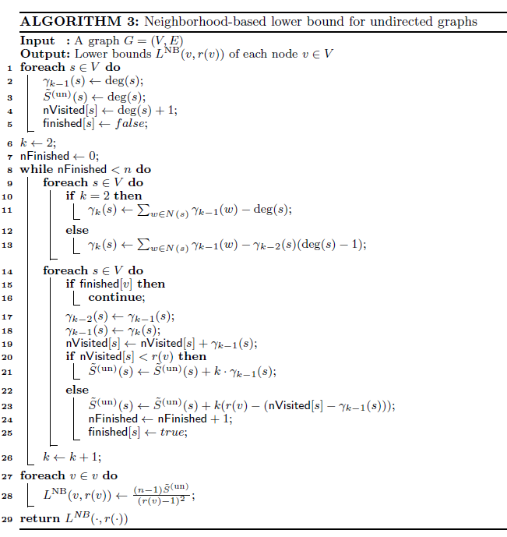

Slide 13
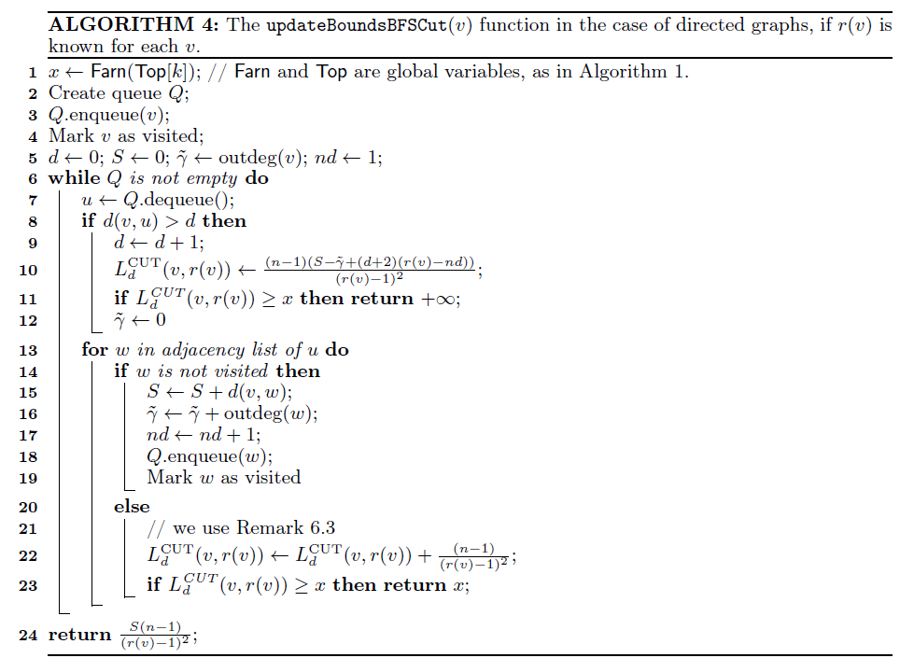

Slide 14
Experiments
Experiment in various real-world network datasets
Compare the two compute bound functions in terms of performance and complexity
Validate intuition regarding degree
Experiment with the TopCloseness implementation of the algorithm in the Networkit package

Slide 15
Conclusion
Fast algorithms for k-closeness centrality are a hard problem.
There is still a lot to be discovered.
Hopefully our contribution is meaningful.

